Slide 1
HS Corpus Linguistics / Korpuslinguistik 5. Representation formats & corpus queries
Prof. Dr. Stephanie Evert
Chair of Computational Corpus Linguistics
www.linguistik.uni-erlangen.de

Slide 2
Catching up: Overview of existing corpora

Slide 3
Types of corpora
written vs. spoken vs. multimodal/multi-media
reference corpus vs. specialized corpus
synchronic vs. diachronic (discrete, continuous)
closed corpus vs. monitor corpus
monolingual vs. multilingual (parallel, comparable)
unannotated (raw text) vs. annotated
metadata = information about texts & speakers/authors
linguistic annotation = systematically coded interpretation
corpus size: small & clean vs. large & messy
measured in M = million (or G = billion) running words

Slide 4
Some corpora everybody should know
Brown Corpus (Francis & Kucera 1964)
American English, written (edited), texts published in 1961
500 samples @ 2000 words from 15 text genres (categories)
Brown Family
Brown (AmE, 1961), LOB (BrE, 1961) – Frown (AmE, 1991), FLOB (BrE, 1991) – BLOB (BrE, 1931), BE2006 (BrE, 2006)
Penn Treebank (Marcus, Santorini & Marcinkiewicz, 1993)
ca. 3 million words of AmE with syntactic analyses (parse trees)
British National Corpus (Aston & Burnard 1998)
British English, 90% written / 10% spoken, collected ca. 1991
approx. 100 million words in 4048 files (= texts / collections)
Web as Corpus: WaCky (Baroni et al. 2009)
ca. 2 billion words of text from automatically crawled Web pages for each of DE, EN, FR, IT
many other Web as Corpus projects: larger corpora, additional languages (Arachnea, COW, SkE 10¹⁰)
Notes:
Brown = Brown University, RI (W. Nelson Francis & Henry Kucera)
LOB = Lancaster – Oslo – Bergen
Frown/FLOB = Freiburg
BLOB = Before LOB, Lancaster
Penn Treebank = U of Pennsylvania, Philadelphia, PA
BNC first released in 1994
→ im Deutschen wesentlich schlechtere Datenlage!

Slide 5
Corpora: English
British National Corpus 100 M
BNC v2 in progress, with texts from around 2015
Movie subtitles (DESC) 90 M
Gigaword newspaper corpus 4 G
current: 5th edition (2011) / 2nd edition ca. 2 G words
New York Times Annotated 1.2 G
articles from 1987–2007 with manual categorization
Corpus of Contemporary AmE (COCA) 440 M
only limited access via BYU Web interface
Wackypedia (English Wikipedia of 2009) 1 G
http://www.natcorp.ox.ac.uk/
https://catalog.ldc.upenn.edu/LDC2011T07
https://catalog.ldc.upenn.edu/LDC2008T19
http://corpus.byu.edu/coca/
http://wacky.sslmit.unibo.it/doku.php?id=corpora

Slide 6
Corpora: Other languages
Few reference corpora available (similar to BNC)
American National Corpus aborted at 15 M words
German DeReKo (53 G words) and DWDS (balanced core 100 M, extension 28 G) only with limited Web access
Frantext only paid & limited Web access (ca. 200 M words)
Hungarian National Corpus (ca. 100 M words)
Corpus Brasileiro (ca. 1 G words)
most w/o substantial amounts of spoken language
Newspaper corpora difficult to acquire
LexisNexis does not allow systematic download & analysis
newspaper publishers often ask steep prices
http://www.anc.org/
https://cosmas2.ids-mannheim.de/cosmas2-web/
http://www.dwds.de/ressourcen/korpora/
http://www.frantext.fr/
http://corpus.nytud.hu/mnsz/index_eng.html
http://corpusbrasileiro.pucsp.br/cb/Inicial.html
http://www.lexisnexis.com/

Slide 7
Corpora: Parallel corpora
EuroParl debates of the EU Parliament 10 – 60 M
parallel corpus with translations into 21 EU languages
aligned at sentence level
OpenSubtitles 2016 up to 2.5 G
parallel corpus of movie subtitles in 60 languages
Parallel Web corpus (linguatools) ca. 200 M
http://diates.lingfil.uu.se/Europarl.php
http://diates.lingfil.uu.se/OpenSubtitles2016.php
http://linguatools.org/tools/corpora/webcrawl-parallel-corpus-german-english-2015/

Slide 8
Corpora: Web corpora
WaCky (Web as Corpus kool ynitiative) ca. 2 G
first publicly available Web corpora (EN, DE, FR, IT)
Aranea collection 1 G
Web corpora in 12 languages
Corpora from the Web (COW) 5 – 20 G
up-to-date Web corpora in DE, EN, FR, ES, NL, SV
USENET newsgroup corpus ca. 7 G
newsgroup postings from 2005–2011
Global Web-based English (GloWbE) ca. 2 G
onle limited Web access via BYU
TenTen corpus family (≥ 10¹⁰ tokens in many languages) up to 36 G
only accessible in commercial Sketch Engine
Crawl your own (specialized) corpus with BootCaT
http://wacky.sslmit.unibo.it/doku.php?id=corpora
http://sketch.juls.savba.sk/aranea_about/
http://corporafromtheweb.org/
http://www.psych.ualberta.ca/~westburylab/downloads/usenetcorpus.download.html
http://corpus.byu.edu/glowbe/
https://www.sketchengine.eu/documentation/tenten-corpora/
http://bootcat.dipintra.it/

Slide 9
Catching up: Corpus design

Slide 10
Representativeness & sampling
Representativeness: corpus as completely random sample
language = extensional population, i.e. a (possibly infinite) collection of utterances
randomly select n objects from population
Design criteria ➞ sampling frame
dices up and defines linguistic population ➞ make relevant texts identifiable
“A sampling frame is an operational definition of the population, an itemized listing of population members from which a representative corpus can be chosen.” (Biber 1993, 244)
pick specified number of items from each cell (related to stratified sampling)
language
spoken
written
sampling frame
Notes:
sampling frame dices up linguistics population based on metadata categories
e.g. spoken vs. written; age group of speaker/author; text type / genre; …
categories often “orthogonal” to each other, but sometimes different subdivisions (e.g. text type | mode)
find specified number of available text for each cell of the grid ➞ ensures balance, approximates random sampling

Slide 11
Representativeness & sampling
Definition of a sampling frame
fundamental distinctions: mode (spoken/written/written-to-be-spoken), medium
text characteristics: (publication) date, author (single/multi/anon), region, target audience, …
function of text: genre / text type (factuality, purpose, situation, …), topic domain, …
properties of author/speaker: sex, age, dialect, social class, …
see Atkins et al. (1992) for a comprehensive system of categories
Balance
include texts from all (combinations of) categories in the sampling frame = grid cells
avoids bias/skew ➞ balanced coverage of the “language” population
Representativeness
sampling frame makes population identifiable (for each combination of categories) ➞ random selection of texts for each cell
must specifiy proportion of texts to be sampled from each category = prevalence in language

Slide 12
Brainstorming
How would you design a corpus for a study of evaluative language in music reviews?
… or another research question?

Slide 13
Representation formats

Slide 14
Corpus annotation: raw text + metadata
It seemed a day much as any other until I happened to look out of the back window. There was a little garden behind the house; a well-mown lawn surrounded by a neatly cut hedge, a few bushes and colourful flowers.
metadata
title: The Garden
author: Stefan Evert
author sex: male date: 05.08.1991

Slide 15
Corpus annotation: tokenization
It seemed a day much as any other until I happened to look out of the back window . There was a little garden behind the house ; a well-mown lawn surrounded by a neatly cut hedge , a few bushes and colourful flowers .

Slide 16
Corpus annotation: sentence segmentation
<s> It seemed a day much as any other until I happened to look out of the back window . </s>
<s> There was a little garden behind the house ; a well-mown lawn surrounded by a neatly cut hedge , a few bushes and colourful flowers . </s>

Slide 17
Corpus annotation: part-of-speech (POS) tagging
<s> It_{PP} seemed_{VBD} a_{DT} day_{NN} much_{RB} as_{IN} any_{DT} other_{JJ} until_{IN} I_{PP} happened_{VBD} to_{TO} look_{VB} out_{RP} of_{IN} the_{DT} back_{JJ} window_{NN} ._{SENT} </s>
<s> There_{EX} was_{VBD} a_{DT} little_{JJ} garden_{NN} behind_{IN} the_{DT} house_{NN} ;: a_{DT} well-mown_{VBN} lawn_{NN} surrounded_{VBN} by_{IN} a_{DT} neatly_{RB} cut_{VBN} hedge_{NN} ,, a_{DT} few_{JJ} bushes_{NNS} and_{CC} colourful_{JJ} flowers_{NNS} ._{SENT} </s>

Slide 18
Corpus annotation: lemmatization
<s> It_{PP}^{it} seemed_{VBD}^{seem} a_{DT}ª day_{NN}^{day} much_{RB}^{much} as_{IN}^{as} any_{DT}^{any} other_{JJ}^{other} until_{IN}^{until} I_{PP}^{I} happened_{VBD}^{happen} to_{TO}^{to} look_{VB}^{look} out_{RP}^{out} of_{IN}^{of} the_{DT}^{the} back_{JJ}^{back} window_{NN}^{window} ._{SENT}. </s>
<s> There_{EX}^{there} was_{VBD}^{be} a_{DT}ª little_{JJ}^{little} garden_{NN}^{garden} behind_{IN}^{behind} the_{DT}^{the} house_{NN}^{house} ;:; a_{DT}ª well-mown_{VBN}??? lawn_{NN}^{lawn} surrounded_{VBN}^{surround} by_{IN}^{by} a_{DT}ª neatly_{RB}^{neatly} cut_{VBN}^{cut} hedge_{NN}^{hedge} ,,, a_{DT}ª few_{JJ}^{few} bushes_{NNS}^{bush} and_{CC}^{and} colourful_{JJ}^{colorful} flowers_{NNS}^{flower} ._{SENT}. </s>
need a better representation format

Slide 19
XML markup of annotation Standard for data interchange & archiving
root element
element annotated with attributes
<corpus>
<story num="6" title="The Garden">
<p>
<s>
<token pos="PP" lemma="it">It</token>
<token pos="VBD" lemma="seem">seemed</token>
<token pos="DT" lemma="a">a</token>
<token pos="NN" lemma="day">day</token>
<token pos="RB" lemma="much">much</token>
<token pos="IN" lemma="as">as</token>
<token pos="DT" lemma="any">any</token>
<token pos="JJ" lemma="other">other</token>
<token pos="IN" lemma="until">until</token>
<token pos="PP" lemma="I">I</token>
</s>
</p>
</story>
</corpus>
start tag of XML element
corresponding end tag

Slide 20
XML markup of annotation Standard for data interchange & archiving
XML declaration
<?xml version="1.0" encoding="UTF-8"?>
<corpus>
<story num="6" title="The Garden">
<p>
<s>
<token pos="PP" lemma="it">It</token>
<token pos="VBD" lemma="seem">seemed</token>
<token pos="DT" lemma="a">a</token>
<token pos="NN" lemma="day">day</token>
<token pos="RB" lemma="much">much</token>
<token pos="IN" lemma="as">as</token>
<token pos="DT" lemma="any">any</token>
<token pos="JJ" lemma="other">other</token>
<token pos="IN" lemma="until">until</token>
<token pos="PP" lemma="I">I</token>
...
</s>
</p>
</story>
</corpus>

Slide 21
XML markup of annotation Standard for data interchange & archiving
<?xml version="1.0" encoding="UTF-8"?>
<corpus>
<metadata>
<author>
<name>Stefan Evert</name>
<sex>male</sex>
</author>
<publication>
<title>Very Short Stories</title>
<type>collection</type>
<genre>fiction</genre>
</publication>
</metadata>
<story num="6" title="The Garden">
<p>
<s>
<token pos="PP" lemma="it">It</token>
<token pos="VBD" lemma="seem">seemed</token>
<token pos="DT" lemma="a">a</token>
<token pos="NN" lemma="day">day</token>
...
metadata header

Slide 22
XML standards
XML (Extensible Markup Language) is a widely-used standard for structured annotation
A well-formed XML document only specifies the structure of annotation, not its semantics
DTD (document type declaration) or XML Schema specify valid element names, their attributes and how they can be nested
still doesn't explain semantics without documentation!
Exchange formats for text corpora: TEI (Text Encoding Initiative), XCES (Corpus Encoding Standard), ISO 24612: LAF (Linguistic Annotation Framework)
but more efficient representation required for corpus search etc.

Slide 23
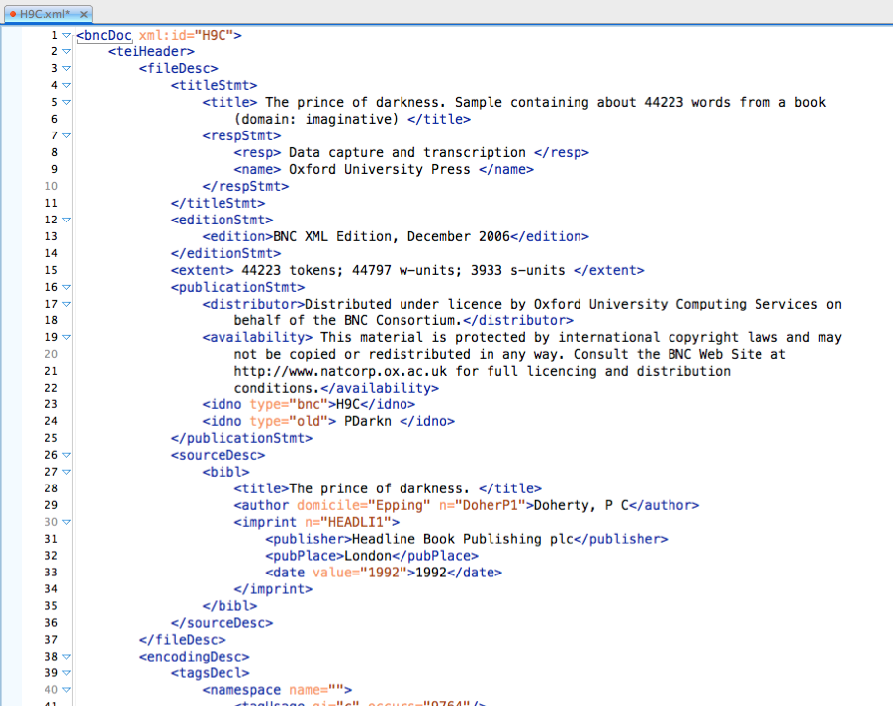
TEI standard (BNC)
TEI header = metadata
text from British National Corpus
information about this text

Slide 24
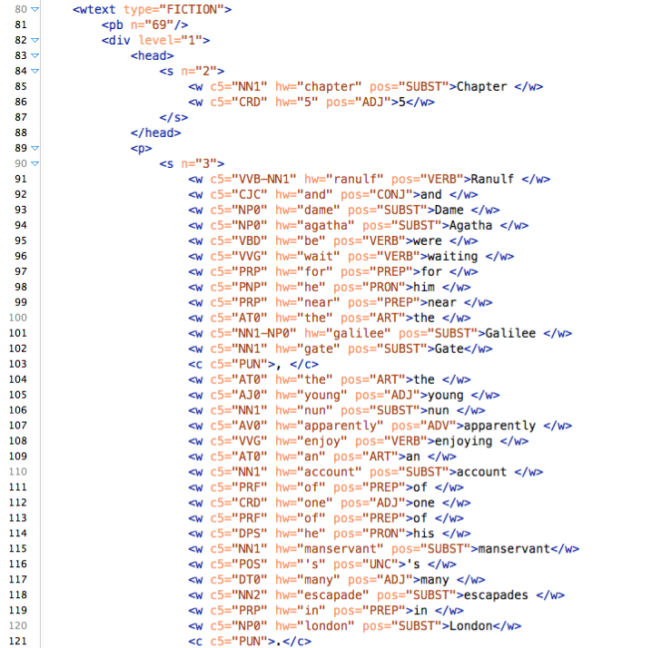
TEI standard (BNC)
TEI body = object data + annotation
structure & typographic markup
tokens + token-level annotations
principle:
raw text (= object data) can be reconstructed by deleting all XML tags

Slide 25
Vertical text format (.vrt) Simpler, more efficient format ➞ used by CWB & NLP tools
<corpus>
<story title="The Garden">
<p>
<s>
It PP it
seemed VBD seem
a DT a
day NN day
much RB much
as IN as
any DT any
other JJ other
until IN until
I PP I
...
</s>
</p>
</story>
</corpus>
metadata
title: The Garden
author: Stefan Evert
author sex: male date: 05.08.1991
TAB characters (\t, \x09)

Slide 26
Vertical text format (.vrt) Text metadata encoded in XML start tags (not in header!)
<corpus>
<text title="The Garden" author="Stefan Evert" author_sex="male" date="1991-08-05">
<p num="1">
<s>
It PP it
seemed VBD seem
a DT a
day NN day
much RB much
as IN as
any DT any
other JJ other
until IN until
I PP I
...
</s>
</p>
</text>
</corpus>
CQPweb requires <text>, SketchEngine prefers <doc>
sub-text level metadata

Slide 27
CoNLL format Vertical text without the metadata
http://universaldependencies.org/docs/format.html
# story: "The Garden"
# paragraph #1
1 It PP it
2 seemed VBD seem
3 a DT a
4 fine JJ fine
5 day NN day
6 . SENT .
1 There EX there
2 was VBD be
3 an DT a
4 elephant NN elephant
5 . SENT .
# this is the end of the file
these are just comments
blank lines = sentence boundaries
token numbers (within sentence)

Slide 28
CWB data model Efficient binary format used by indexing & query tools
# word pos lemma 0 A DET a
1 fine ADJ fine
2 example NN example
3 . PUN .
4 Very ADV very
5 fine ADJ fine
6 examples NN example
7 ! PUN !
corpus position (“cpos”)

Slide 29
CWB data model Efficient binary format used by indexing & query tools
# word pos lemma
(0) <text id="42" lang="English">
(0) <s> 0 A DET a
1 fine ADJ fine
2 example NN example
3 . PUN .
(3) </s>
(4) <s>
4 Very ADV very
5 fine ADJ fine
6 examples NN example
7 ! PUN !
(7) </s>
(7) </text>
XML tags inserted as “invisible” tokens

Slide 30
CWB data model Efficient binary format used by indexing & query tools
p-attributes
# word pos lemma
(0) <text id="42" lang="English">
(0) <s> 0 A DET a
1 fine ADJ fine
2 example NN example
3 . PUN .
(3) </s>
(4) <s>
4 Very ADV very
5 fine ADJ fine
6 examples NN example
7 ! PUN !
(7) </s>
(7) </text>
XML regions
represented
internally as
ranges of
tokens, i.e.
start/end cpos
id="42" lang="English"
s-attributes

Slide 31
Corpus queries

Slide 32

CQPweb
https://corpora.linguistik.uni-erlangen.de/cqpweb/
Login: studentX (1 … 15)
Password: erlangen
Background information
Hardie (2012); Evert & Hardie (2011)
http://cwb.sourceforge.net/
Documentation: YouTube tutorial videos https://www.youtube.com/user/CorpusWorkbench
CEQL*
*http://cwb.sourceforge.net/ceql.php

Slide 33
Other Web UIs @ FAU
BNCweb https://corpora.linguistik.uni-erlangen.de/bncweb/
Login: studentX (1 … 15)
Password: erlangen
for use with textbook Corpus Linguistics with BNCweb – a Practical Guide (Hoffmann et al. 2008)
EuroParl debates https://corpora.linguistik.uni-erlangen.de/demos/CQP/Europarl/
HGC German Newspapers https://corpora.linguistik.uni-erlangen.de/demos/auth/HGC/
Login: demo
Password: demo
annotated with morphological information
CEQL*
CEQL*
CEQL*
*http://cwb.sourceforge.net/ceql.php

Slide 34
Other Web interfaces using the same CWB technology
OPUS collection of parallel corpora
Leeds IntelliText (multilingual, Web corpora)
BFSU CQPweb (Chinese & English corpora at BFSU)
Linguateca AC/DC (Portuguese)
Hungarian National Corpus
Corpus del Español Actual (Spanish)
Varitext (French)
Spraakbanken (Swedish)
KorpusDK (Danish)
Georgetown University CQPweb (some free corpora)
http://diates.lingfil.uu.se/
http://corpus.leeds.ac.uk/itweb/htdocs/Query.html
http://111.200.194.212/cqp/
http://www.bfsu-corpus.org/channels/corpus
http://www.linguateca.pt/ACDC/
http://corpus.nytud.hu/mnsz/index_eng.html
http://spanishfn.org/tools/cea/english
http://syrah.uni-koeln.de/varitext
http://spraakbanken.gu.se/parole/
http://ordnet.dk/korpusdk/
https://corpling.uis.georgetown.edu/cqp/

Slide 35
Other Web interfaces using the same CWB technology
TSCorpus (Turkish)
CORIS/CODIS (Italian)
SSLMIT La Repubblica (Italian newspapers)
BwanaNet (Catalan, Spanish, English)
PolMine (German political corpora)
Perugia Corpus (Italian)
CorpusEye (several languages, few free corpora)
CorpusWiki initative (multilingual, still very small)
http://tscorpus.com/
http://corpora.ficlit.unibo.it/
http://dev.sslmit.unibo.it/corpora/corpus.php?path=&name=Repubblica
http://bwananet.iula.upf.edu/
http://polmine.sowi.uni-due.de/cwb/
https://www.unistrapg.it/cqpweb/
http://corp.hum.sdu.dk/
http://www.corpuswiki.org/

Slide 36
Further Web interfaces
BYU Corpora (by Mark Davies)
COCA, COHA, Soap Operas, GloWbE, TIME, Spanish, Portuguese, …
Google Web 1T 5-Grams (n-gram database)
search n-gram tables, pre-computed (quasi-)collocation
NetSpeak offers a nicer Web interface to the database
Google Books Ngram Viewer (info)
visualize frequency changes over time (words, phrases)
Linguee: English, German, French
Web-crawled parallel corpora for many language pairs
useful to find possible translations (but caveat emptor)
Treebank.info (automatically parsed corpora)
Commercial Sketch Engine platform
many large & small corpora in different languages
free access for master students in EMLex (MA Lexikographie)
https://www.english-corpora.org
http://corpora.linguistik.uni-erlangen.de/cgi-bin/demos/Web1T5/Web1T5_freq.perl
http://www.netspeak.org/
https://books.google.com/ngrams/
https://books.google.com/ngrams/info
http://www.linguee.de/
http://www.linguee.com/
http://www.linguee.fr/
http://treebank.info/
https://www.sketchengine.eu/

Slide 37
Simple query syntax
Most Web interfaces offer a “simple” query syntax
simply type a word or phrase
limited support for wildcards
In this course: CEQL syntax
relatively powerful simple query language
supported by BNCweb, CQPweb and a few other UIs
Tutorial & documentation
Ch. 6 of Hoffmann, Sebastian et al. (2008). Corpus Linguistics with BNCweb – a Practical Guide, vol. 6 of English Corpus Linguistics. Peter Lang, Frankfurt.
official documentation: https://cwb.sourceforge.io/ceql.php
CQPweb simple query manual
https://cqpweb.lancs.ac.uk/doc/cqpweb-simple-syntax-help.pdf

Slide 38
CEQL quickstart
speak matches specific word form
{speak} matches all inflected forms
at the end of the day specific phrase
is n't it \? tokenization rules & escapes
*able suffix -able
+able without the word able
light_JJ the adjective light
Mr _N* person (male)
[Mr,Mrs] _N* person (male or female)
Mr _N* {be} _J* what is said about the person
Mr (_N*)+ {be} (_RB)? _J*

Slide 39
CEQL quickstart
Smith:C turn off case folding
deja:d vu:d ignore diacritics
\D number (one or more digits)
\u\u\u\u:C acronym (4 uppercase letters, e.g. YMCA)
\u\L:C starts with uppercase letter
take * off optional word
take ++*** off between 2 and 5 words
in ( _JJ* )? time optional adjective
Mr (_N*)+ {be} (_RB)? _J* what is said about a person (refined query)
his ( _JJS | most _JJ )* _N* alternatives
<s> but start of sentence
<ne_type=PERSON> (+)+ </ne_type>

Slide 40
CQPweb & CEQL practice
What are the most frequent uber- words?
Search for your favourite topic (one or more lemmas)
In which year and newspaper is it most frequent?
Carry out a collocation analysis for this topic
Find different kinds of numbers and acronyms
Can you identify predications like austerity is good?
Find different types of named entities
What are the typical patterns of headlines? (<title> …)

Slide 41
CQP query syntax
Formal query notation
based on regular expression at multiple levels
allows precise specification of search pattern
much more flexible and powerful than CEQL syntax
Supported by all CWB-based Web interfaces!
Tutorial & documentation
Ch. 12 of Hoffmann, Sebastian et al. (2008). Corpus Linguistics with BNCweb – a Practical Guide, vol. 6 of English Corpus Linguistics. Peter Lang, Frankfurt.
CQP Query Language Tutorial (online version)
http://cwb.sourceforge.net/files/CQP_Tutorial.pdf
http://cwb.sourceforge.net/files/CWB_Encoding_Tutorial/

Slide 42
CQP queries: single tokens
Quoted regexp matches surface form of a token
"(over|under)\w+" or '(over|under)\w+'
duplicate embedded quotes: """" matches "
Append flags for case/diacritic-insensitive search
"deja"%c … case-insensitive
"deja"%d … ignore diacritics
"deja"%cd … both
"?"%l … literal string (no metacharacters)

Slide 43
Regular expressions
Regular expressions (regexp) are a sophisticated formal wildcard notation from computer science, used to describe patterns of characters or other elements
Fundamental building blocks of regular expressions
(…)? optional element (0 or 1)
(…)* any number of repeats, incl. 0 (Kleene star)
(…)+ at least one repetition
(…|…|…) alternatives
nesting of such elements makes regexp very powerful
CEQL uses regexp notation over tokens
for optional tokens, repetitions and alternatives
CQP & full-text search use regexp notation over individual characters (letters, digits, punctuation, …)
CQP also uses regexp notation over tokens (➞ later)
Different regexp “flavours”: CQP supports PCRE
POSIX, PCRE = Perl-compatible regexp, Python, Oniguruma, …

Slide 44
PCRE regular expressions PCRE = Perl-compatible regular expressions
(…)? = optional (0 or 1)
(…)* = any number of repeats (0 or more)
(…)+ = at least one repeat (1 or more)
(…){3} = exactly 3
(…){2,4} = between 2 and 4
applies to single character if parentheses are omitted
(…|…|…) = alternatives (matches exactly one)
. = any character (matchall)
esp.: .? (optional character), .* (arbitrary string), .+
escapes: \. = ., \* = *, \? = ?, \+ = +, …

Slide 45
PCRE regular expressions PCRE = Perl-compatible regular expressions
[aeiou] = character class (matches exactly one)
[a-z] = [abc … z] and [A-Z] = [ABC … Z]
[0-9] = [0123456789]
[^aeiou] = everything(!) except [aeiou]
escape sequences:
\w = letters, digits and _ (word character)
\s = any single whitespace (blank, TAB, newline, …)
\d = digit
\pL = letter, \p{Ll} = lowercase, \p{Lu} = uppercase
\pN = digit, \p{Cyrillic} = cyrillic letter, …
see https://www.pcre.org/original/doc/html/pcrepattern.html#SEC5

Slide 46
CQP queries: single tokens
Search token annotation with attribute-regexp pair:
[lemma = "(over|under)\w+_ADJ"] (BNC)
[pos = "AJS"] … superlatives (BNC)
"deja"%cd is shorthand for [word = "deja"%cd]
Combine constraints with Boolean operators:
operators: & (and), | (or), ! (not), != (doesn't match)
[(word="can"%c) & (pos!="VM.*")]
same as: [(word="can"%c) & !(pos="VM.*")]
All examples for BNCweb with CLAWS tagset
token description

Slide 47
CQP queries: token sequences
CQP queries are regular expressions over token descriptions ([…])
"in" [pos="AJ.*"]? [hw="year"] … optional
"in" [pos="AJ.*"]+ [hw="year"] … one or more
"in" [pos="AJ.*"]{2} [hw="year"] … exactly two
([pos="AJS"] | "most"%c [pos="AJ0"]) … either
Skipping arbitrary tokens
[] … matchall (any token)
"dog" []{0,4} "cat" … within 5-token span
"dog" []{0,4} "cat" within s … must not cross a sentence boundary (s-attribute)

Slide 48
CQP queries: s-attributes
XML tags match start/end of s-attribute regions
<head> "UK" … as first word of heading
"UK" </head> … as last word of heading
<head> … doesn't match anything (0 tokens)
<mw> []* </mw> … paired tags match entire region
Search within a region:
"Twain" within quote;
[pos="NN.*"] :: match.mw_pos = "PRP"; … add “global constraint” to check s-attribute annotation
pre-defined anchors: match, matchend, target (@)

Slide 49
CQP queries: token sequences
Repetition operators and alternatives can be nested to search for complex lexicogrammatical patterns:
([pos="AJS"] | "most"%c [pos="AJ0"])
( "(and|\,)"%c ([pos="AJS"] | "most"%c [pos="AJ0"])
)+
[pos = "NN.*"]
Matching strategy defaults to non-greedy
"ho"%c ("," "ho"%c)+ … always matches ho, ho
(?longest) "ho"%c ("," "ho"%c)+ … recent CQP versions support inline modifier at start of query
What does this query do?

Slide 50
CQP query practice
Find noun compounds / names with 4+ components
What are the longest compounds/names in the BNC?
Find bare nouns (e.g. went to school)
Find co-occurrences of coffee and drink (5-word span)
Find verb-object combinations (active voice)
design flexible pattern for matching noun phrases
don't forget about phrasal verbs and adverbs
What are the typical patterns of headlines?
Does your query account for all headlines in the BNC?
Can you find inflected forms of verbs (≠ base form)?
hint: normalize(word, "c") ➞ lowercased word form

